Slide 1
TASK 11 - UNDERSTANDING THE REASONS FOR STUDENT DEBT CRISIS: SOCio-ECONOMIC IMPACT

Slide 2
OECD AND MEMBER STATES
An inter-governmental economic organisation with 37 member countries, founded in 1961 to stimulate economic progress and world trade. It is a forum of countries describing themselves as committed to democracy and the market economy, providing a platform to compare policy experiences, seek answers to common problems, identify good practices and coordinate domestic and international policies of its members.
Generally, OECD members are high-income economies with a very high Human Development Index (HDI) and are regarded as developed countries.
OECD countries and Key Partners represent about 80% of world trade and investment.
1

Slide 3
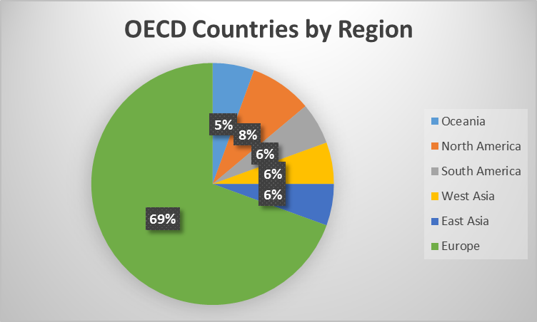
OECD AND MEMBER STATES
DATA SOURCE:
https://en.wikipedia.org/wiki/OECD
2

Slide 4
inDICATORS AND MEANING
GDP/employee(US$,inflation-adjusted)
Description: The average Gross Domestic Products per employee during the giving year, counted by constant 2011 purchasing power parity US$
GDP total, yearly growth
Description: Based on Gapminder’s per capita, PPP
Inflation (Annual %)
Description: Inflation as measured by the annual growth rate of the GDP implicit deflator shows the rate of price change in the economy as a whole. The GDP implicit deflator is the ratio of GDP in currency to GDP in constant local currency.
3

Slide 5
inDICATORS AND MEANING
Government expenditure per student, tertiary
Description: Government expenditure per student is the average general government expenditure (current capital transfers) per student in the given level of education, expressed as a percentage of GDP per capita.
Population growth (Annual %)
Annual population growth for year t is the exponential rate of growth of midyear population from year t-1 to t, expressed as a percentage. Population is based on the de facto definition of population, which counts all residents regardless of legal status or citizenship.
Human Development Index
Human Development Index is an index used to rank countries by level of “human development “. It contains three dimensions: health level, educational level and living standard.
4

Slide 6
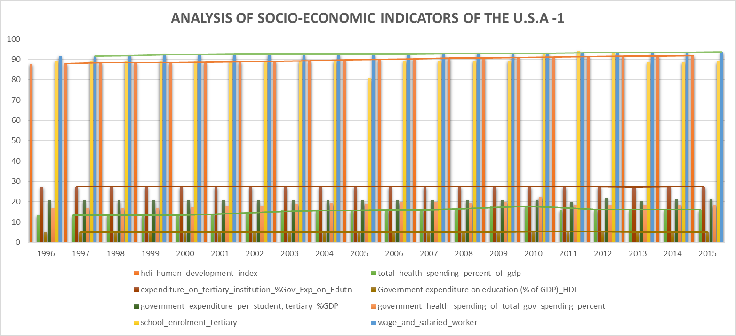
CHARTS AND FINDINGS
Percentage Ranking (in %)
DATA SOURCE:
http://hdr.undp.org/en/data#
https://www.gapminder.org/data/
https: data.worldbank.org
5

Slide 7
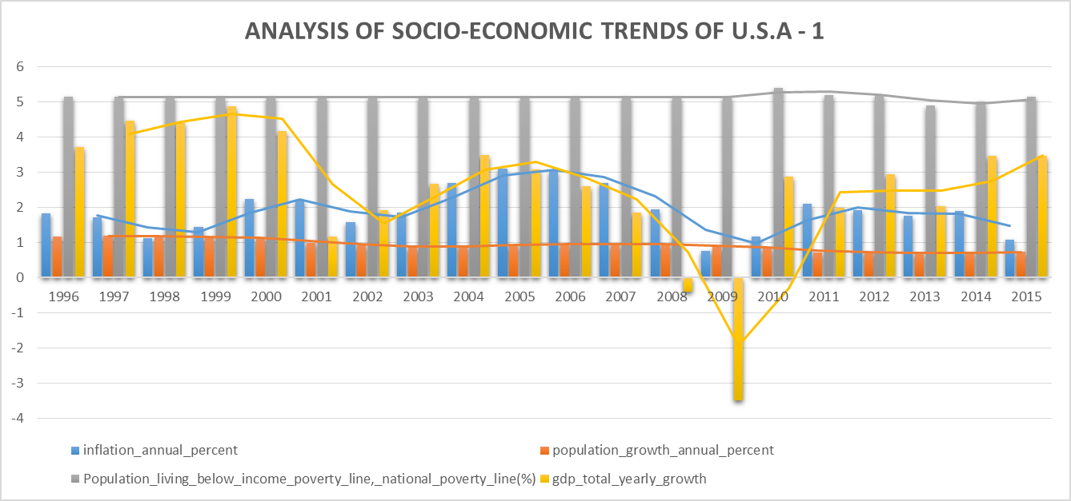
CHARTS AND FINDINGS
Percentage Ranking (in %)
DATA SOURCE:
https: data.worldbank.org
https://www.rug.nl/ggdc/productivity/pwt
https://www.ilo.org/ilostat
6

Slide 8
INSIGHTS ON U.S.A SOCIO-ECONOMIC TRENDS
Indicators such as 'inflation annual percent‘ and 'GDP total yearly growth' have experience steady increase from 2010 to 2015. While 'Human Development Index', 'school enrollment tertiary' and 'wage and salaried workers' are relatively high over the years.
'government health spending of total government spending percent' and 'total health spending as percentage of GDP' have steadily increase over the years. Furthermore, 'expenditure on tertiary institution as percentage of government spending on education' has remain constant.
'Government expenditure on education as percentage of GDP' has been constant, however it is less than 50% of total government spending on health while expenditure on health keeps increasing. 'Population living below income poverty line considering national poverty line' remains relatively low as compared to 'wage and salaried workers'.
7

Slide 9
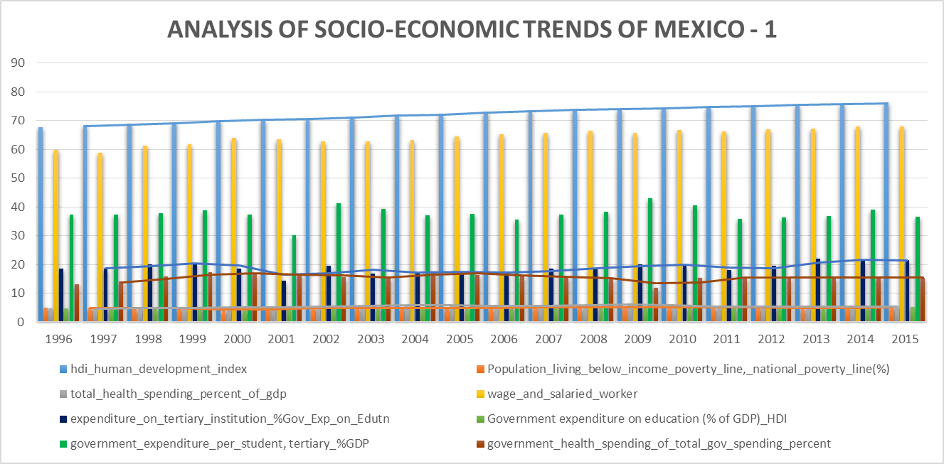
CHARTS AND FINDINGS
Percentage Ranking (in %)
DATA SOURCE:
http://hdr.undp.org/en/data#
https://www.gapminder.org/data/
https: data.worldbank.org
8

Slide 10
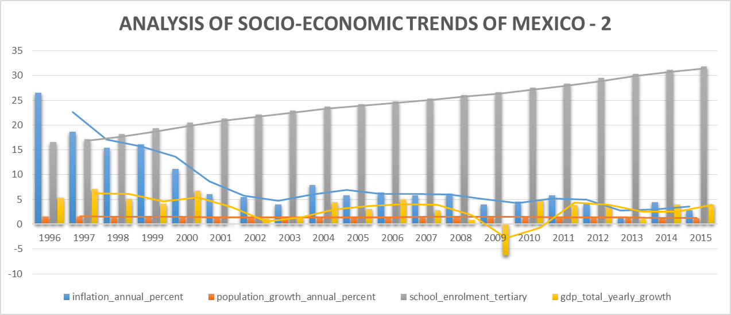
CHARTS AND FINDINGS
Percentage Ranking (in %)
DATA SOURCE:
https: data.worldbank.org
https://www.rug.nl/ggdc/productivity/pwt
https://www.ilo.org/ilostat
9

Slide 11
INSIGHTS ON MEXICO’S SOCIO-ECONOMIC TRENDS
While 'inflation annual percent', 'GDP total yearly growth' have observe steady decrease through the years. However, 'Human Development Index', 'school enrollment tertiary' and 'wage and salaried workers' have remain relatively high.
'government health spending of total government spending percent' has been constant but it's around 50% of government spending on education as percentage of GDP' and while 'total health spending as percentage of GDP' remain relatively low over the years. Furthermore, 'expenditure on tertiary institution as percentage of government spending on education' has steadily increase across the years as compared to expenditure on health.
'Government expenditure on education as percentage of GDP' has been consistent even at the face of inconsistent GDP growth. 'Population living below income poverty line considering national poverty line' remains relatively low as compared to 'wage and salaried workers', which is high.
10

Slide 12
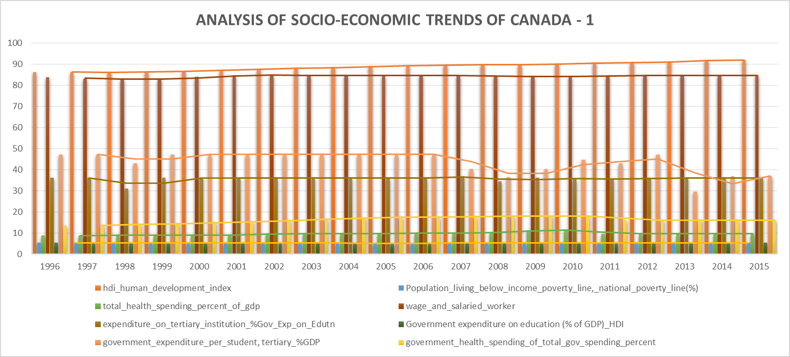
CHARTS AND FINDINGS
Percentage Ranking (in %)
DATA SOURCE:
http://hdr.undp.org/en/data#
https://www.gapminder.org/data/
https: data.worldbank.org
11

Slide 13
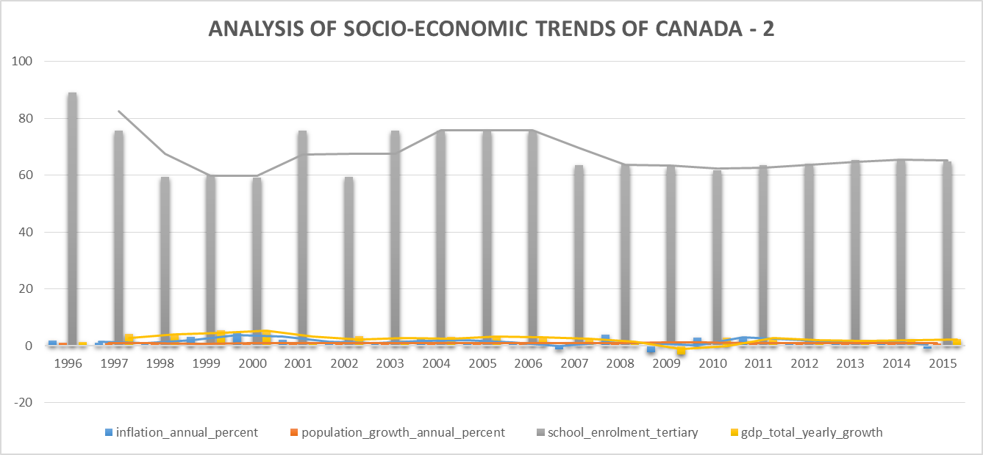
CHARTS AND FINDINGS
Percentage Ranking (in %)
DATA SOURCE:
https: data.worldbank.org
https://www.rug.nl/ggdc/productivity/pwt
https://www.ilo.org/ilostat
12

Slide 14
INSIGHTS ON CANADA’S SOCIO-ECONOMIC TRENDS
Indicators such as 'inflation annual percent', 'GDP total yearly growth' and 'population growth annual percent' have not experience any significant increase through the years. Meanwhile 'Human Development Index', 'school enrollment tertiary' and 'wage and salaried workers' have remain relatively high.
'government health spending of total government spending percent' has been steady over the years. However, 'total health spending as percentage of GDP' has remain steadily low. Furthermore, 'expenditure on tertiary institution as percentage of government spending on education' remain constant but its three times the 'total health spending percentage of GDP'.
'Government expenditure on education as percentage of GDP' has been constant and has been around the same level as 'government health spending of total government spending percent'. 'Population living below income poverty line considering national poverty line' remains relatively low as compared to 'wage and salaried workers' which is high.
DATA SOURCE:
https: data.worldbank.org
https://www.rug.nl/ggdc/productivity/pwt
https://www.ilo.org/ilostat
13

Slide 15
PREDICTIONS OF ML MODELS
The predicted data and the actual/verified data are compared with the aid of a regressor line. The line tries to divide through the data points(predicted and actual data) by passing through the best path.
As seen from the charts, IBM Watson ML has a better result as compared to manually built random forest regressor. This can be verified from the charts and also the performance metrics shown after this slides. Even though, they are both great.
14

Slide 16
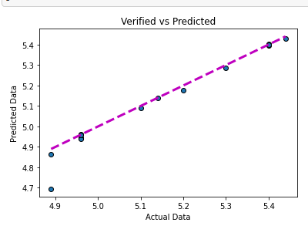
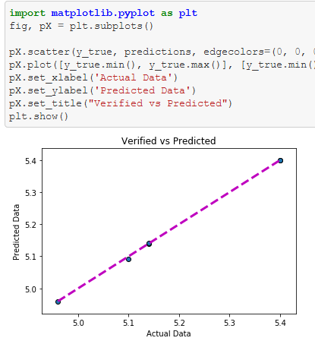
PREDICTIONS OF ML MODELS
RANDOM FOREST REGRESSOR
AUTO ML – IBM WATSON
Target Response(Y): Government expenditure on education as percentage of GDP.
15

Slide 17
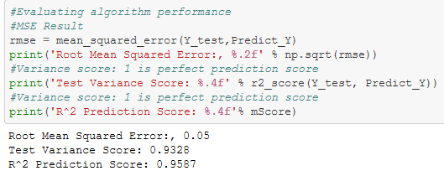
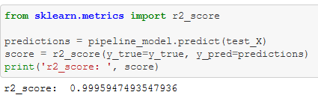
PERFORMANCE METRICS FOR ML MODELS
RANDOM FOREST REGRESSOR
AUTO ML – IBM WATSON
Reference:
•https://github.com/omdena/shapingedu/blob/master/Task14_Modelling/ShapingEduRandomForest_v2.ipynb
•https://github.com/omdena/shapingedu/blob/master/Task14_Modelling/Omdena_ShapingEdu_v2%20-%20P1%20sdk%20notebook.ipynb
•https://github.com/omdena/shapingedu/blob/master/Task14_Modelling/Model_Data_v3.csv
16

Slide 18
CONCLUSION AND RECOMMENDATION
Its advisable for U.S.A to imitate Mexico and Canada in terms of budget for education sector. In addition, just like Canada, tertiary institution in U.S.A should have access to most of the percentage of government’s budget for education. This will reduce student debts because most student debts are recorded in tertiary institutions.
The models build for this purpose are relevant in different ways:
IBM Auto ML if one possess experience in IBM Machine Learning
Random Forest Regressor
17

Slide 19
THANK You!

